Slide 1
Vista Center for the Blind and Visually Impaired
Clinic Operations and Store
NEW Workflow as of March 11, 2024
Modern EHR
Custom SQL
Client Database
Payor Claims, EOB & EFT etc.
Digital payments
Patient Intake forms
Inventory management and reporting
Clinical Note, [Closed loop]
Patient Connection Digital Forms & Patient Portal w/digital Rx
Referring Physician
*Phone
*Inbound Fax

Slide 2
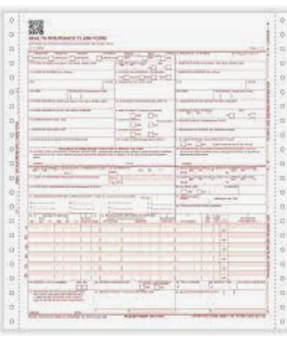
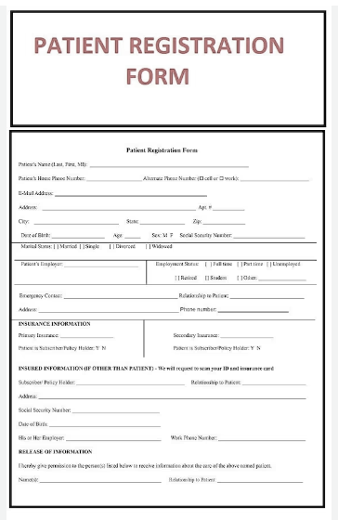
Vista Center for the Blind and Visually Impaired
Clinic Operations and Store
Workflow prior to new EHR [prior to October 2023]
Custom SQL
Client Database
Paper
Claims and Portal EOB
Payor Claims, EOB & EFT etc.
Old EHR for Schedule and Insurance, Demographics
Manual Inventory management and reporting
4 different spreadsheets with outdated info
1. Paper forms and packets mailed or filled out in office
2. Paper Rx
3. No Patient Portal
Patient
Digital payments limited use
Referrals send to Clinic via Docusign
*Phone
*Inbound Fax
Vista Clinic faxes doctors note manually
Referring Physician

